Slide 1

Linear SVM – Hard Margin Classifier
Professor Bo Liu
James Watt School of Engineering

Slide 2

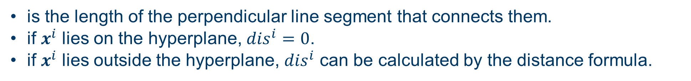


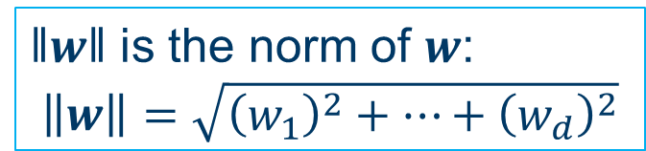

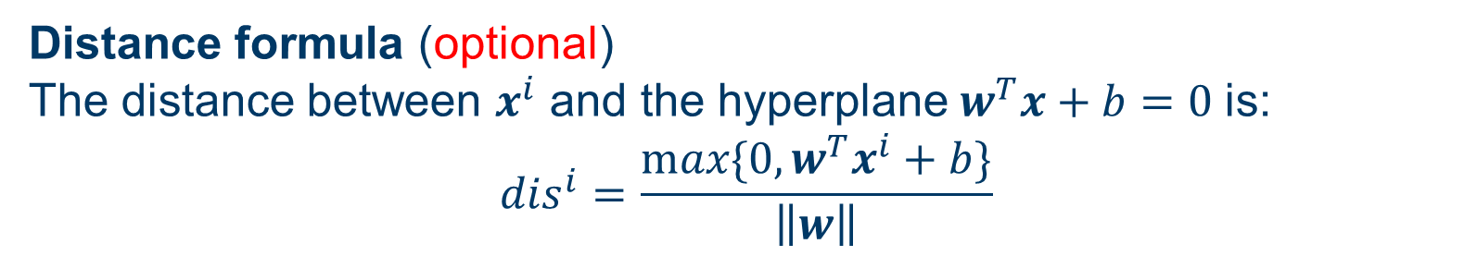


How does SVM work: distance
Distance between a point and a hyperplane
is the length of the perpendicular line segment that connects them.
if $x^{i}$ lies on the hyperplane, ${dis}^{i}=0$.
if $x^{i}$ lies outside the hyperplane, ${dis}^{i}$ can be calculated by the distance formula.
$$H_{1}$$
$$x^{i}$$
$$x^{i}$$
$$H_{2}$$
$$dis$$
$$dis$$
‖𝒘‖ is the norm of $w$:
$$\left\|\text{w}\right\|=\sqrt{{\left(w_{1}\right)}^{2}+⋯+{\left(w_{d}\right)}^{2}}$$
Distance formula (optional)
The distance between $x^{i}$ and the hyperplane$w^{T}x+b=0$ is:
$${dis}^{i}=\frac{max⁡\{0,w^{T}x^{i}+b\}}{\left\|w\right\|}$$

Slide 3

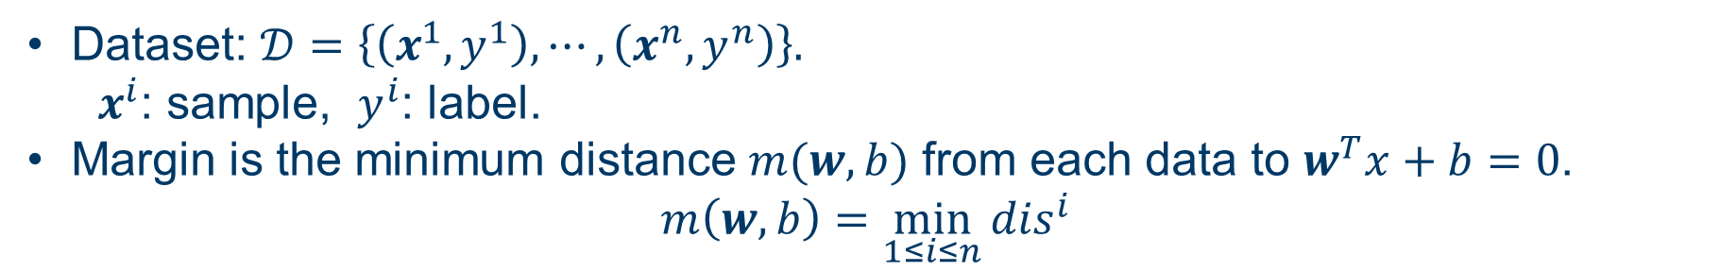

How does SVM work: margin
Margin
Dataset: $𝒟=\left\{\left(x^{1},y^{1}\right), ⋯,\left(x^{n},y^{n}\right)\right\}.$
  $x^{i}$: sample, $y^{i}$: label.
Margin is the minimum distance $m(w,b)$ from each data to $w^{T}x+b=0$.
$$m\left(w,b\right)=\min_{1≤i≤n}{{dis}^{i}}$$
The size of the margin defines the confidence of the classifier.
SVM aims at selecting the hyperplane with the largest margin.
$$H_{1}$$
$$H_{2}$$
class +1
class +1
class -1
class -1

Slide 4
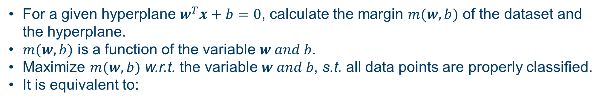
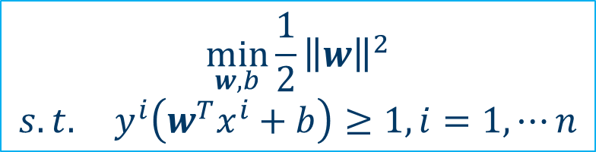
Linear SVM – hard margin classifier
Learning as optimization in SVM
For a given hyperplane $w^{T}x+b=0$, calculate the margin $m(w,b)$ of the dataset and the hyperplane.
$m(w,b)$ is a function of the variable $w and b$.
Maximize $m(w,b)$ w.r.t. the variable $w and b$, s.t. all data points are properly classified.
It is equivalent to:
$$\min_{w,b}{\frac{1}{2}{\left\|w\right\|}^{2}}$$
$$s.t. y^{i}\left(w^{T}x^{i}+b\right)≥1, i=1, ⋯n$$
The derivation is here: Support Vector Machine (SVM) Algorithm (analyticsvidhya.com).
(optional)
We translate a learning problem into an optimization problem.
It can be solved easily.

Slide 5
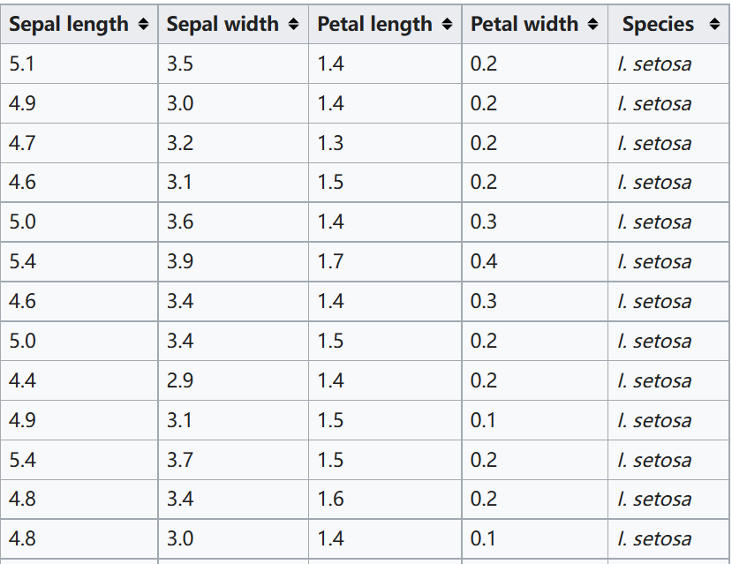
Iris flower classification by SVM using MATLAB
Iris flower classification problem
Features: (sepal length, sepal width, petal length, petal width)
Label: categorical, {setosa, versicolor, virginica}
Number of samples: 150
To make the dataset linearly separable, we only choose:
(sepal length, sepal width)
(setosa, versicolor)

Slide 6
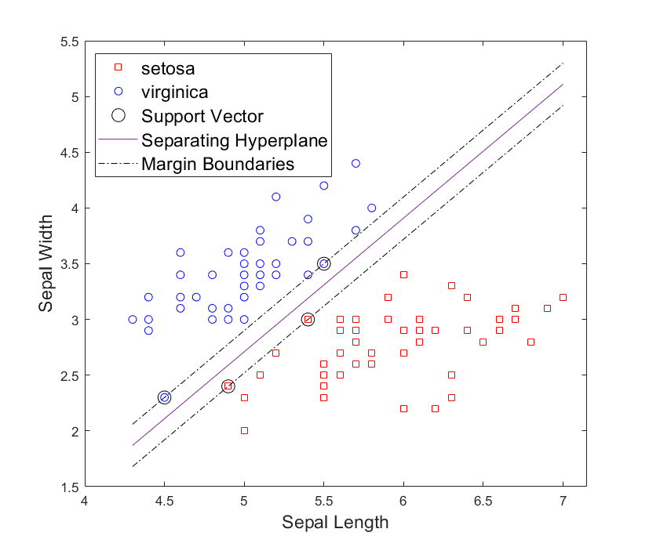
SVM
The results
Full code is given in the MATLAB live script.
See live script

Slide 7




Thanks!
#UofGWorldChangers
@UofGlasgow

